Slide 1
Topic :- Optoelectronics

Slide 2

Content
Introduction of Optoelectronics
Some Images
Optoelectronics Devices
Optical Communication
Advantages
Summary

Slide 3

Introduction To Optoelectronics
Optoelectronics is the study and application of electronic devices that source, detect and control light, usually considered a sub-field of photonics.
Optoelectronic devices are electrical-to-optical or optical-to-electrical transducers, or instruments that use such devices in their operation.
Electro-optics is often erroneously used as a synonym, but is in fact a wider branch of physics that deals with all interactions between light and electric fields, whether or not they form part of an electronic device.

Slide 4

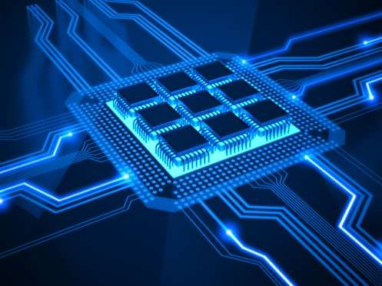
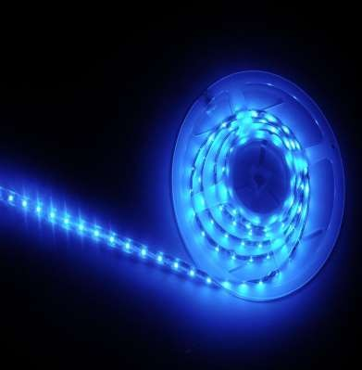
Images of Optoelectronics

Slide 5


Some Optoelectronics Devices
Photodiodes
Photo detector
Photovoltaic Device / Solar Cell
Laser
Diode laser

Slide 6





1. PhotoDiodes
The photodiode is a p-n junction under reverse bias.
Exposing a semiconductor to light can generate electron-hole pairs, which increases the number of free carriers and its conductivity.
Only those that have correct wavelength can be
absorbed by the semiconductor.
Separation of charge can be collected and measured as current or voltage.
If device is left open circuit → voltage detected →
photovoltaic effect
If device is short-circuited (or under reverse bias)
→ photoconductive mode

Slide 7


2. Photo detector
When a photon/light strikes a semiconductor, it can promote an electron from the valence band to the conduction band creating an electron-hole (e-h) pair.
The concentration of these e-h pairs is dependent on the amount of light striking the semiconductor, making the semiconductor works as an optical detector.
There are two ways to monitor the concentration of e- h pairs:
In photodiodes, a voltage bias is present and the concentration of light-induced e-h pairs determines the current through semiconductor.
Photovoltaic detectors contain a p-n junction, that causes the e-h pairs to separate to produce a voltage that can be measured.

Slide 8


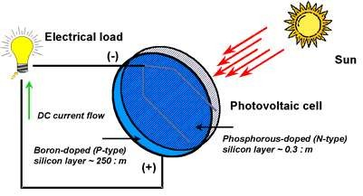
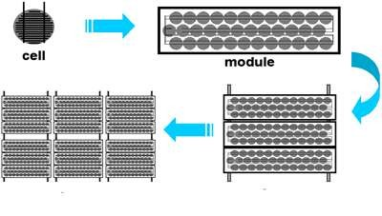
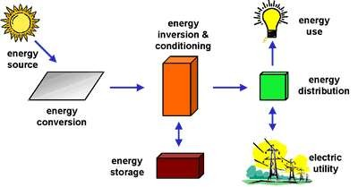
3. Photovoltaic Device / Solar Cell
Photovoltaic devices or solar cells are semiconductor p- n junction that can convert solar radiation into electrical energy.
Diagram of a PV cell.
Photovoltaic cells, modules, panels and arrays.
Major photovoltaic system
components.

Slide 9

5. Laser
For atomic systems in thermal equilibrium, emission of light is the result of two main processes:
ABSORPTION of energy
SPONTANEOUS EMISSION of energy (a
random photon is emitted)
A third mechanism is crucial to the formation of LASER action, which is “STIMULATED EMISSION”.
Light Amplification of Stimulated Emission Radiation

Slide 10



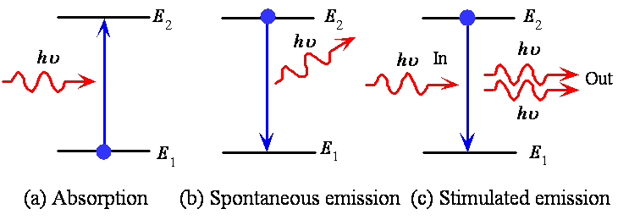
Laser
Basic Optical Transitions

Slide 11

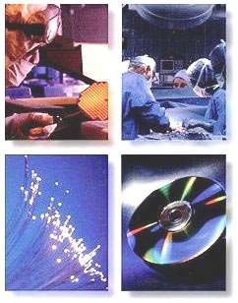
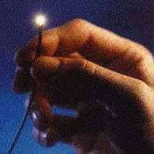


6. Diode Laser
Diode lasers have been used for cutting, surgery, communication (optical fibre), CD writing and reading etc

Slide 12







Optoelectronic communications

Slide 13


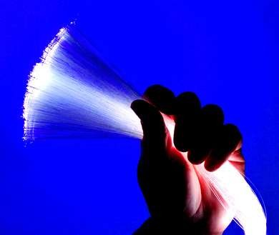
Advantages of Optoelectronics
Compared to copper wire, optical fibers cost less, weigh less, have less attenuation and dispersion and provide more bandwidth.
Highly used in electronic systems

Slide 14

Summary
Optoelectronics market is growing every year
Optoelectronics provide a high bandwidth for communications
Utilize TIR for light propagation in waveguides
Dispersion and attenuation are main drivers in optical fiber design
Interconnections and coupling require precise alignment of optical elements
A number of inter- and intra-chip
connection schemes exist and are being explored.

Slide 15

THANK YOU

